Slide 1
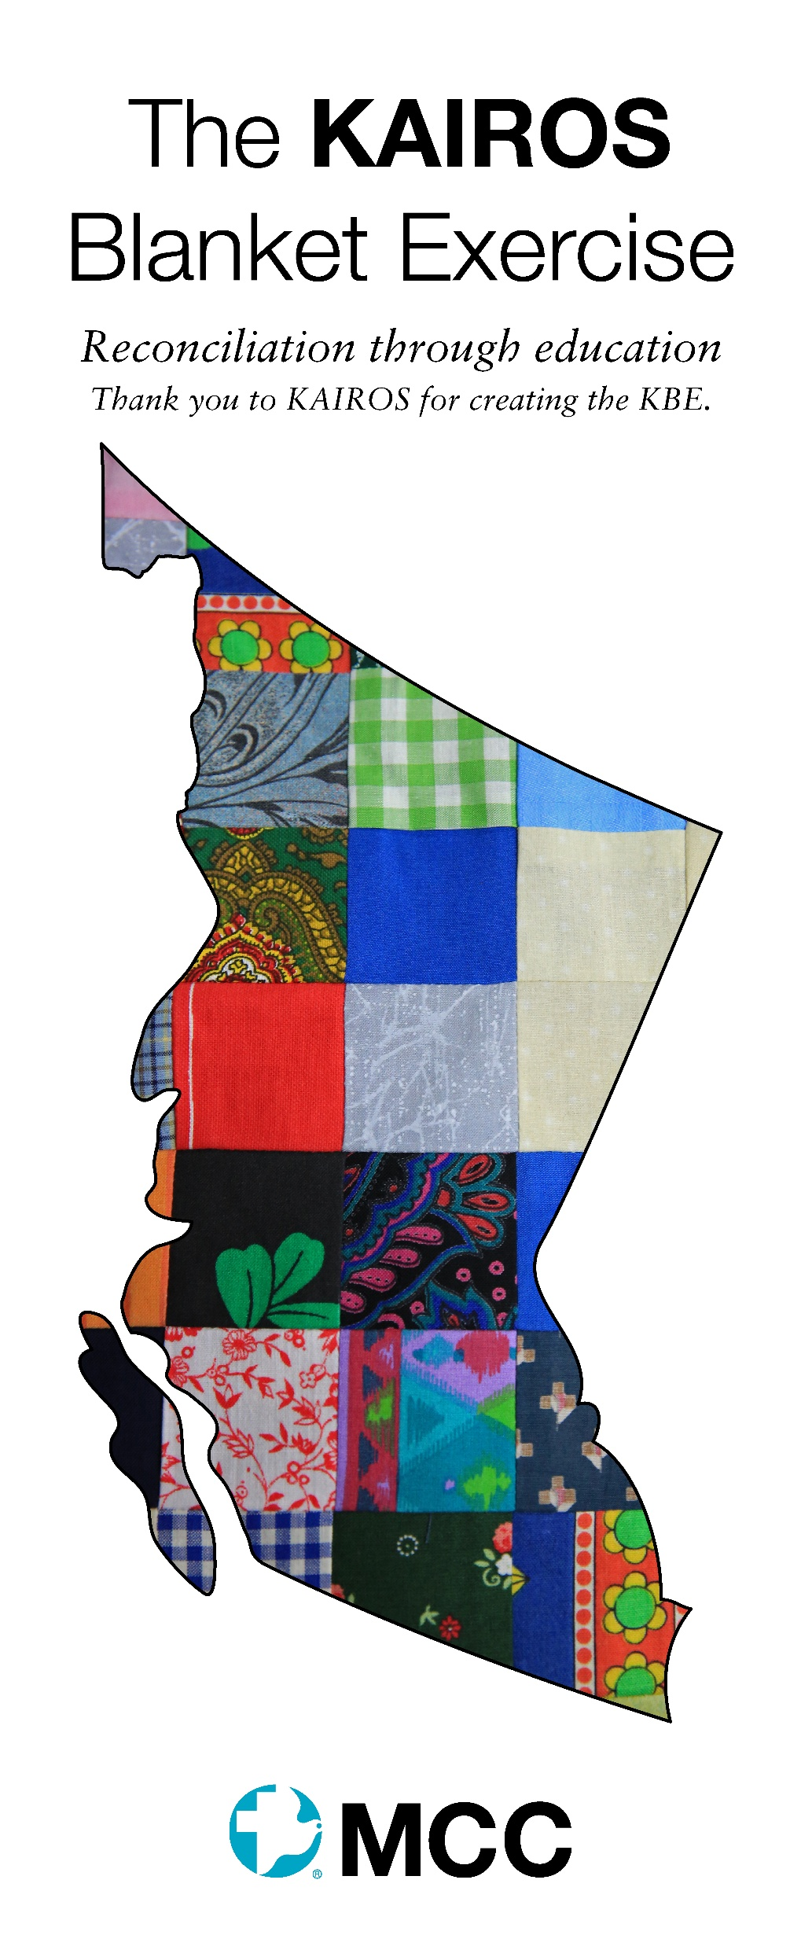
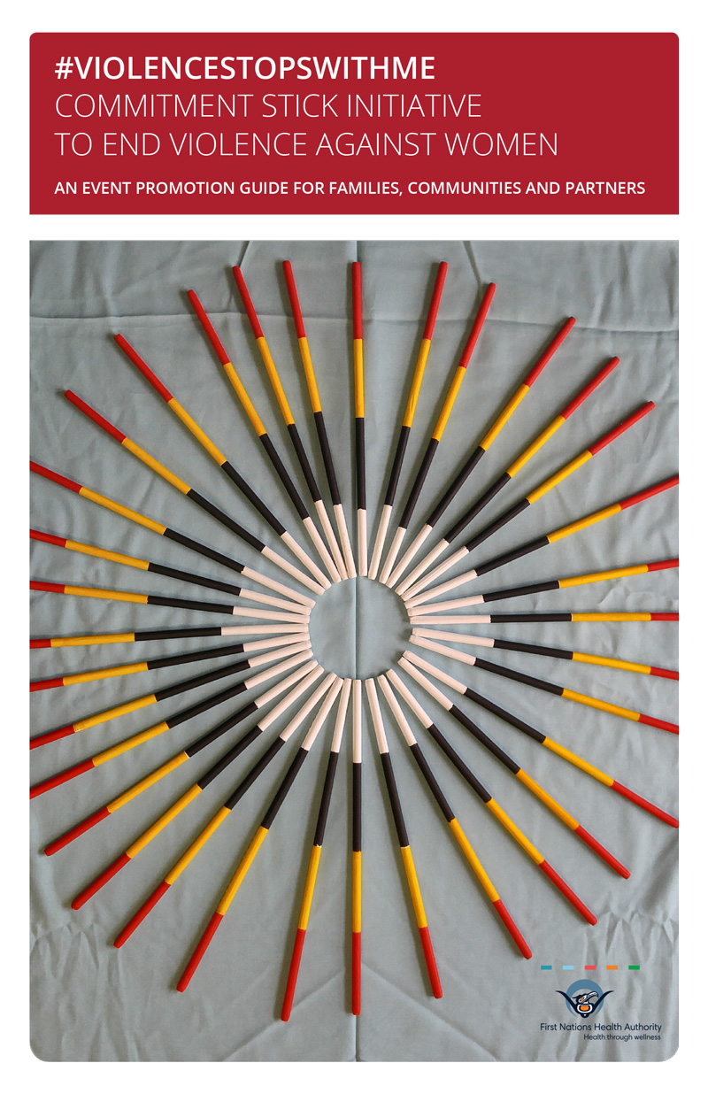
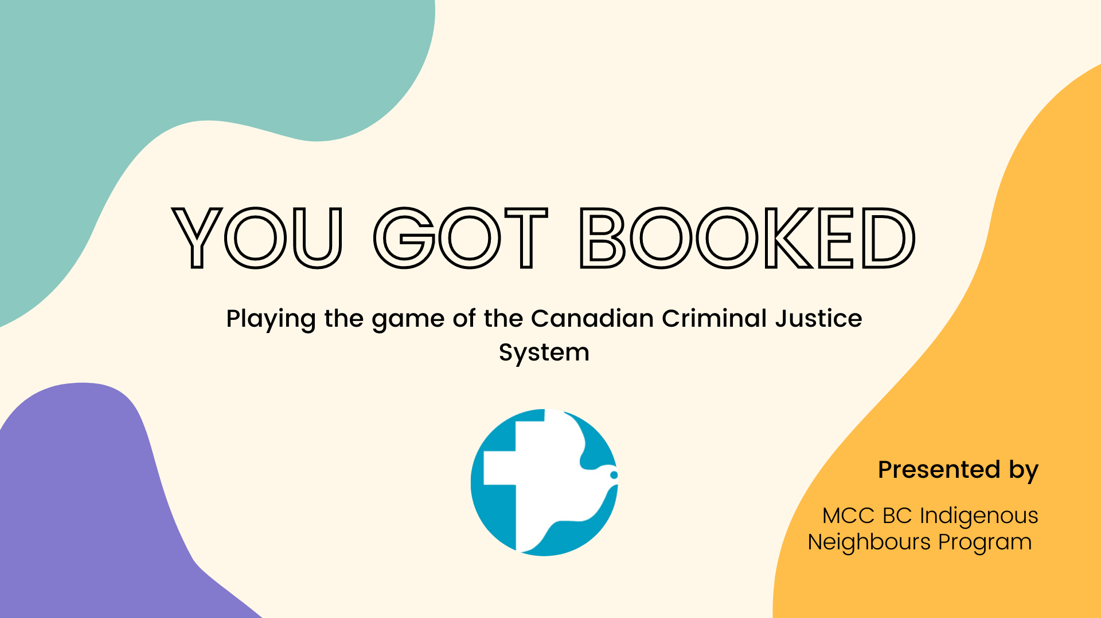
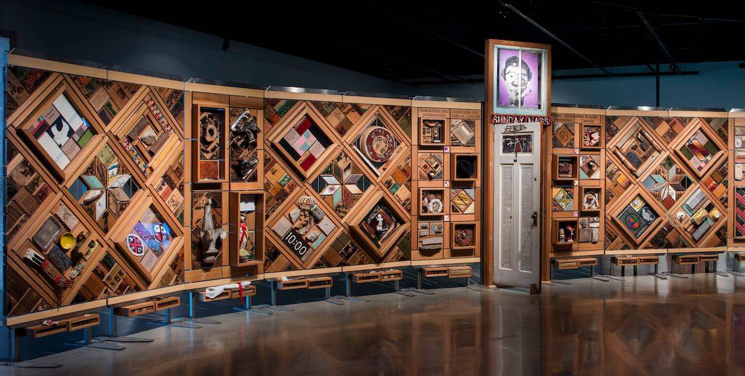
MCC IN Workshops
Interactive Workshops
KAIROS Blanket Exercise (KBE)
Listening to Indigenous Voices
Indigenous 101
You Got Booked & the new, Call 30
The Commitment Stick
The Witness Blanket
Truth and Reconciliation – Calls to Action
Film Studies
Book Studies
KAIROS Blanket Exercise
Listening to Indigenous Voices
MMIWG
The Commitment Stick
You Got Booked
The Witness Blanket

Slide 2

MCC IN Book Studies
15 Book Studies developed and facilitated – usually 4, 6 or 8 sessions
Intotemak – Yours, Mine, Ours
Intotemak – Wrongs to Rights
Intotemak – Quest for Respect
Unsettling the Word – bible stories and verses shared through an Indigenous lens
Braiding Sweetgrass
21 Things You May Not Know About The Indian Act
Five Little Indians
The Land is Not Empty
Namwayut - A Pathway to Reconciliation
Healing Haunted Histories – A Settler Discipleship of Decolonization
Highway of Tears
Truth Telling, Seven Conversations about Indigenous Life in Canada
Serviceberry: Abundance and Reciprocity in the Natural World
Ohpikiihaakan-ohpihmeh (Raised somewhere else): A 60s Scoop Adoptee’s Story of Coming Home

Slide 3
Events
Walk in the Spirit of Reconciliation – this annual event takes place the last weekend of May. We walk local paths that Indigenous children walked being forced to attend St. Mary’s Indian Residential School.
There are presentations and workshops throughout the weekend for participants to attend.
Sponsor Cultural Workshops led by Indigenous people: plant walk or plant knowledge workshop, cedar weaving, making a drum or drum teachings, beading, bus tours offered through Sto:lo Tourism or led by an elder.
Music and Storytelling – Terry & Darlene Wildman with musician Brian Doerksen Song collaboration by Brian, Terry & Darlene. Plus hear about the inspiring work behind the First Nations New Testament led by Terry Wildman.
Host Indigenous Presenters – a time for listening as they share what’s on their heart

Slide 4
MCC Indigenous Neighbours program
MCC strives to build respectful relationships between Indigenous and non-Indigenous people by facilitating education sessions and supporting respectful relationship building.
Thank you for attending today’s session!
MCC Mission Statement: Mennonite Central Committee, a worldwide ministry of churches, sharing God’s love and compassion for all in the name of Christ by responding to basic human needs and working for peace and justice.
MCC Vision Statement: Mennonite Central Committee envisions communities worldwide in right (reconciled) relationship with God (Creator), one another (Indigenous and Non-Indigenous ) and Creation.

